Slide 1
Groofy Code
Competitive Programming Platform

Slide 2

Supervised by:
Dr. Mohamad Abdelwahab
TA: Nada Nasser
Implemented by:
20200136 | Hazem Adel Khalel Nabawy
20200359 | Omar Mohmed Mostafa
20200268 | Doha Abdelbasset Ahmed
20200514 | Marwa Ahmed Mohamed Mubarak
20200501 | Mahmoud Abdelrady Gad
Graduation Project
Academic Year 2023-2024
Final Year Documentation

Slide 3
Table of contents
01
02
04
05
Features
Introduction
- Highlight Features
- Problem Definition
- Problem Solution
03
Implementation
System Analysis
- Technologies
-System Structure
- Use Cases
06
Challenges
07
Machine Learning
Demo
- Model Building Journey

Slide 4
01
Introduction

Slide 5


Introduction & Problem Description
Why don’t I know how to implement it ?
Tasks
Deadlines

Slide 6

Thinking of the solution
What should I do ?
1
Should I solve a lot of problems ?
2
Should I solve hard problems ?
3
What time should I spend in solving ?
4
What about challenging people ?
5
Leetcode ? Codeforces ? ….. etc.

Slide 7



Previous Solutions
Why don’t I know how to implement it ?

Slide 8
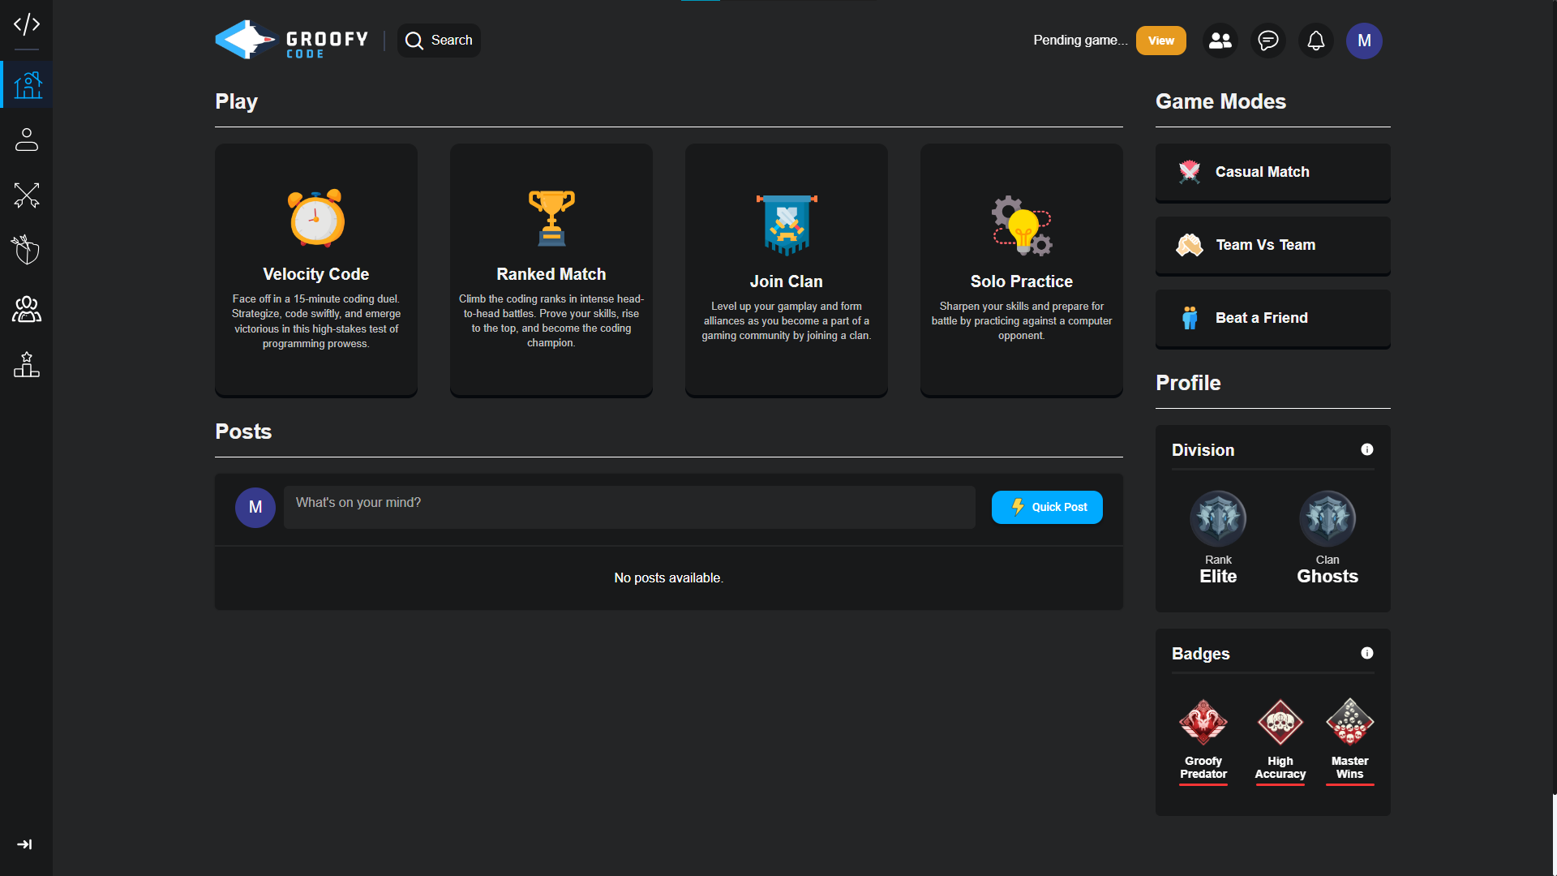
Our Solution: Groofy Code

Slide 9
02
Features

Slide 10
Highlight Features
The key features and functionalities of the project.
1
2
Game Modes
User System
3
4
Clan Features
Chat System

Slide 11
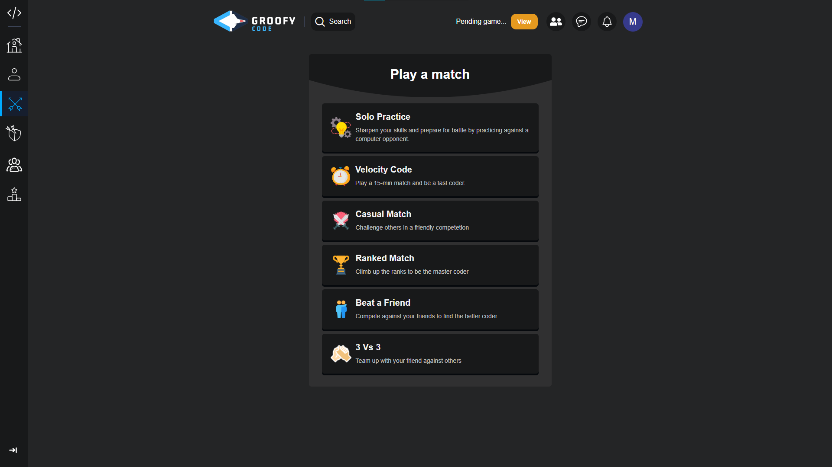
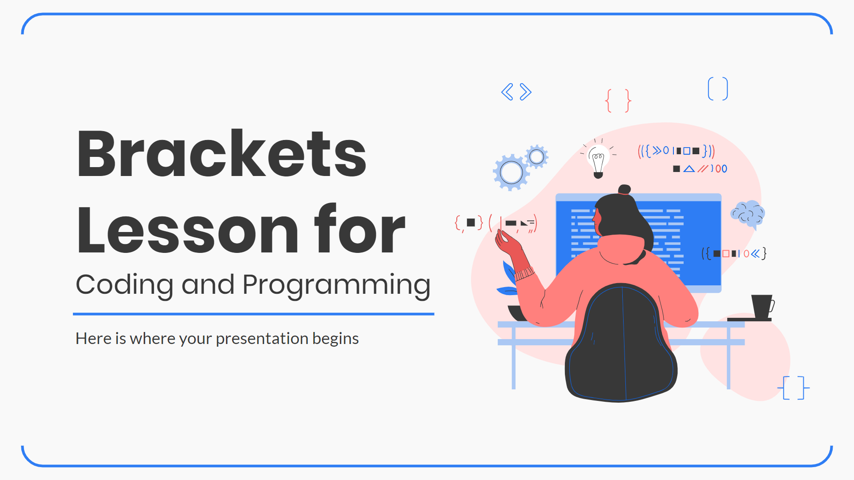
Game Modes
• Solo Practice
• 1 Vs 1 (Ranked)
• Casual Match (Unranked)
• Beat a Friend
• Team Vs Team
• Velocity Match

Slide 12
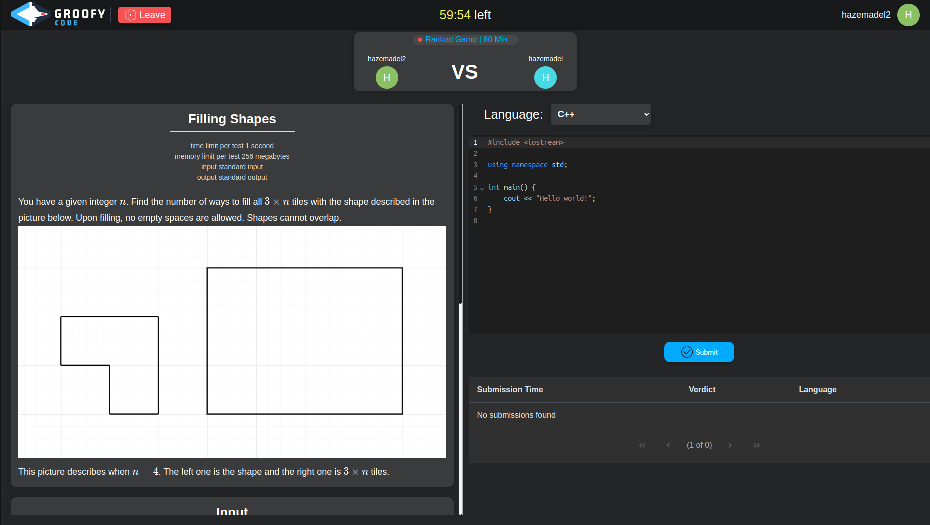
Match Challenge
• Match players Using ML
• Code Editor
• Submission and Result

Slide 13
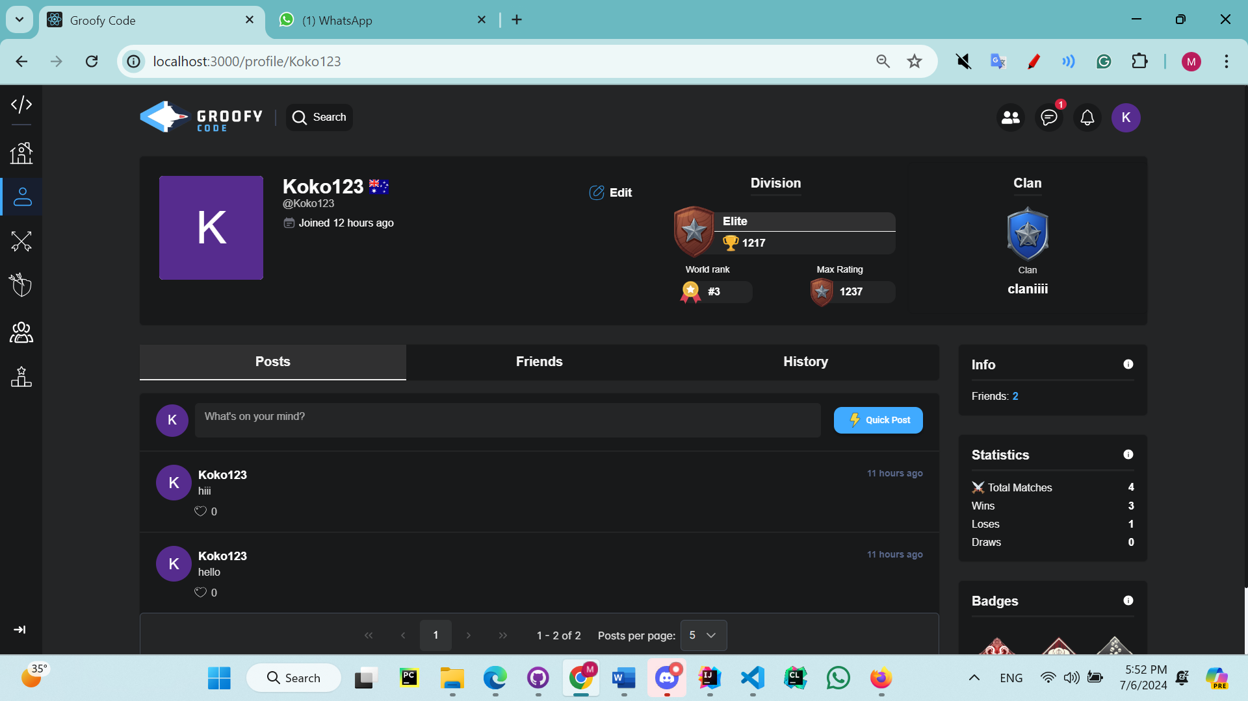
User Profile
• User signup / Login
• Profile Settings
• Game History
• User Statistics

Slide 14
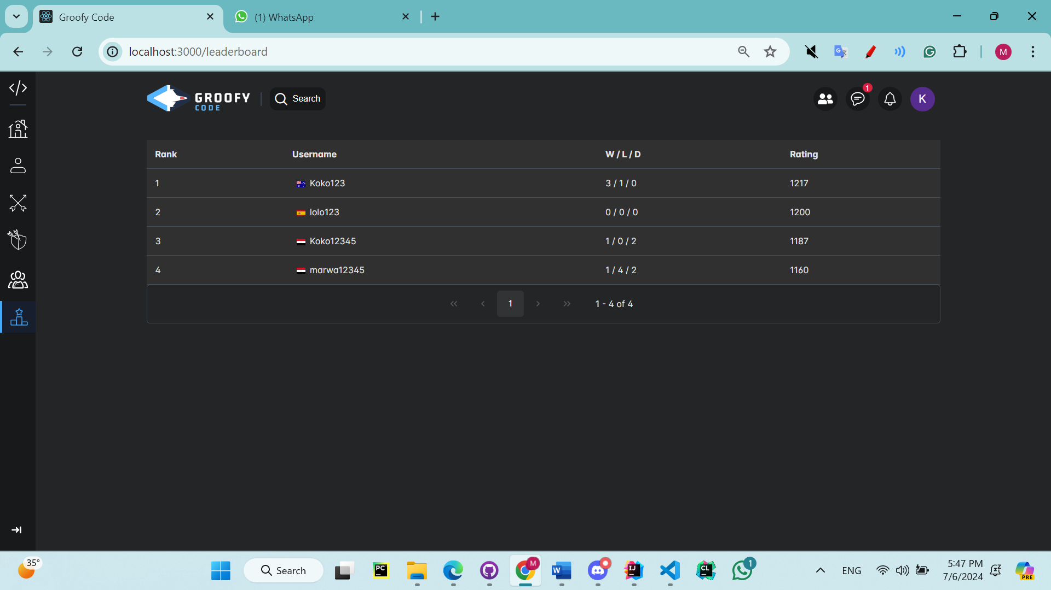
User Interactions
• View users’ profile
• Friend Requests
• Notification system
• Invite a Friend to Match
• Join clan/team
• Posts
• Leaderboard

Slide 15
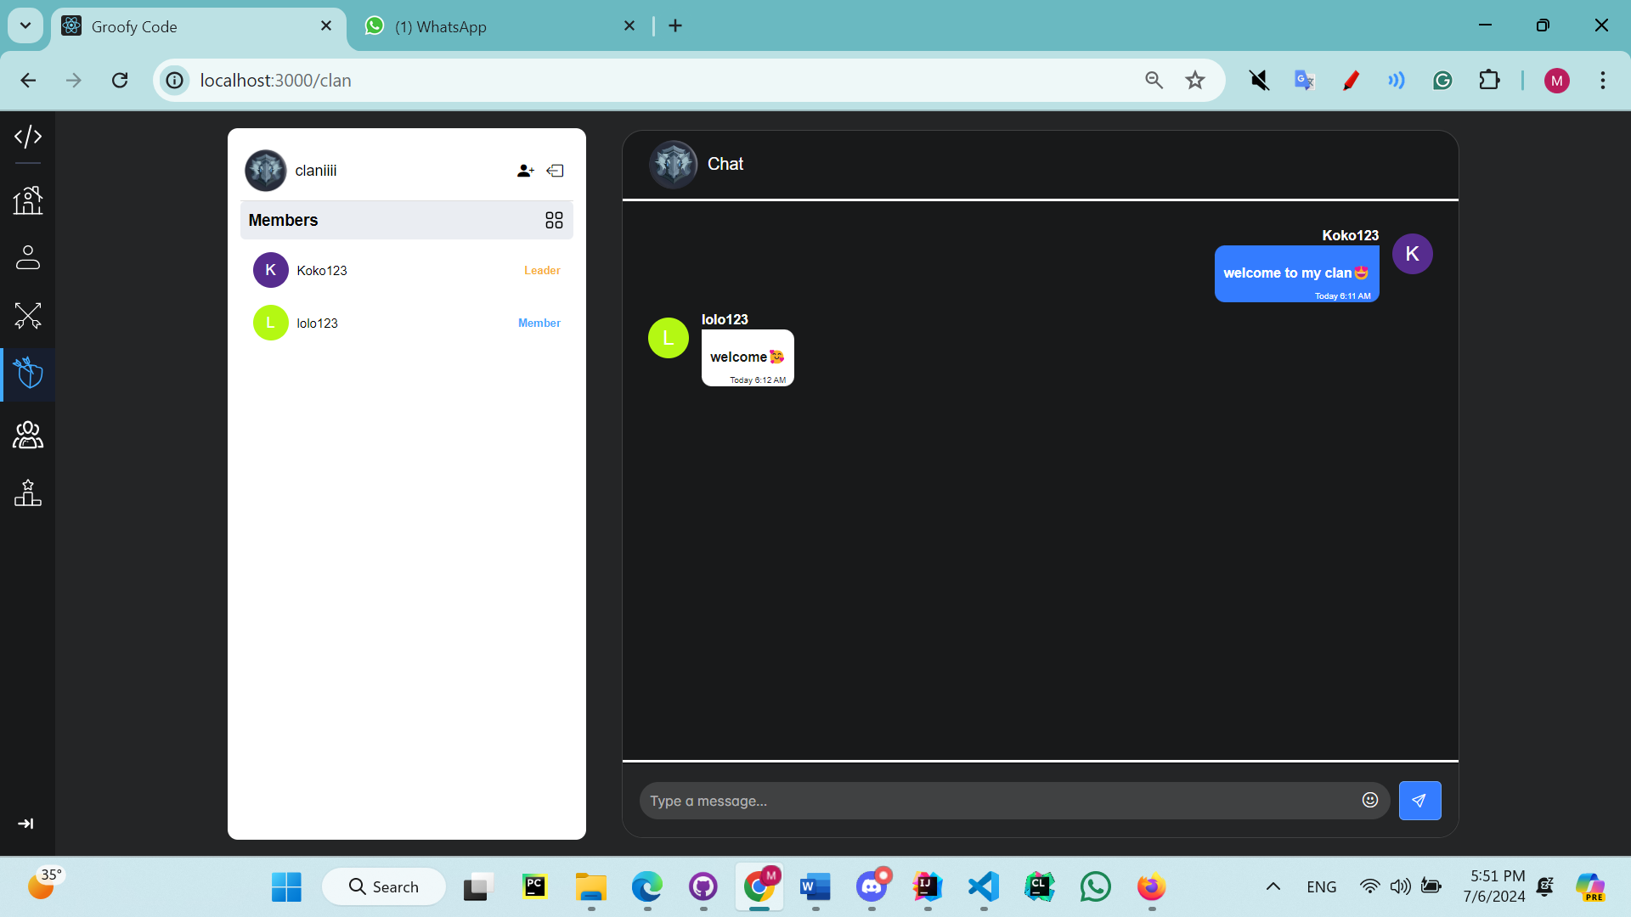
Clan Feature
• Join/leave Clan
• Viewing Clan members
• Collaborate with people
• Chat

Slide 16
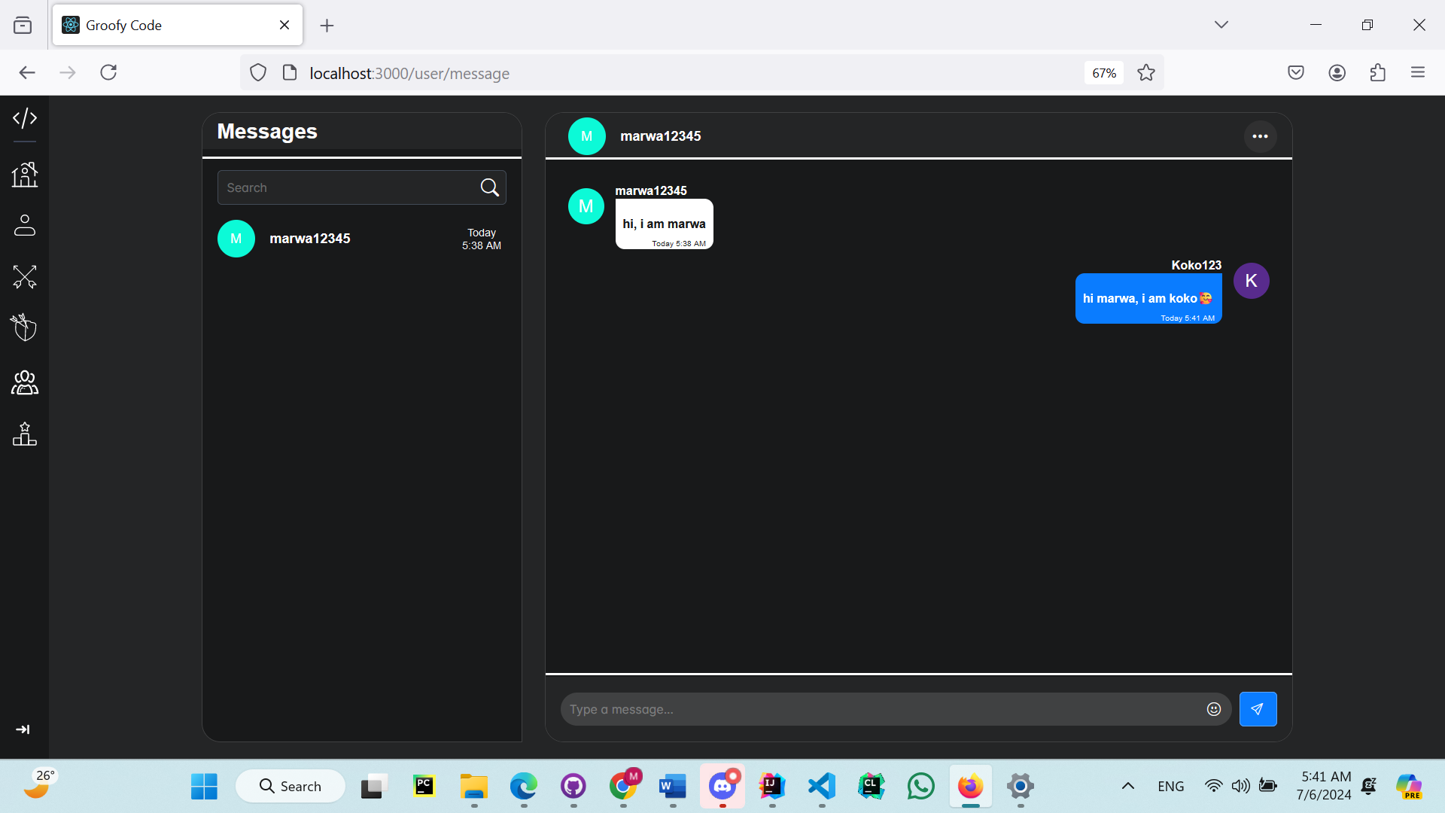
Chat System
• Viewing Friends
• Search for a friend
• Message a user

Slide 17
03
System Architecture

Slide 18
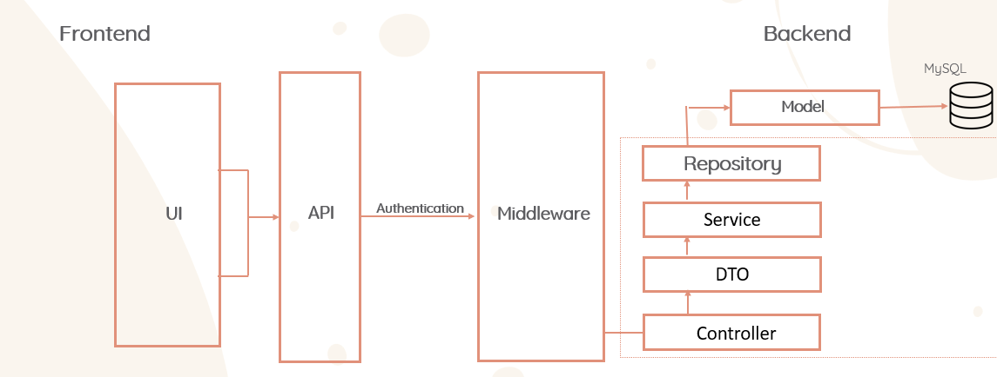
Architecture (MVC)

Slide 19
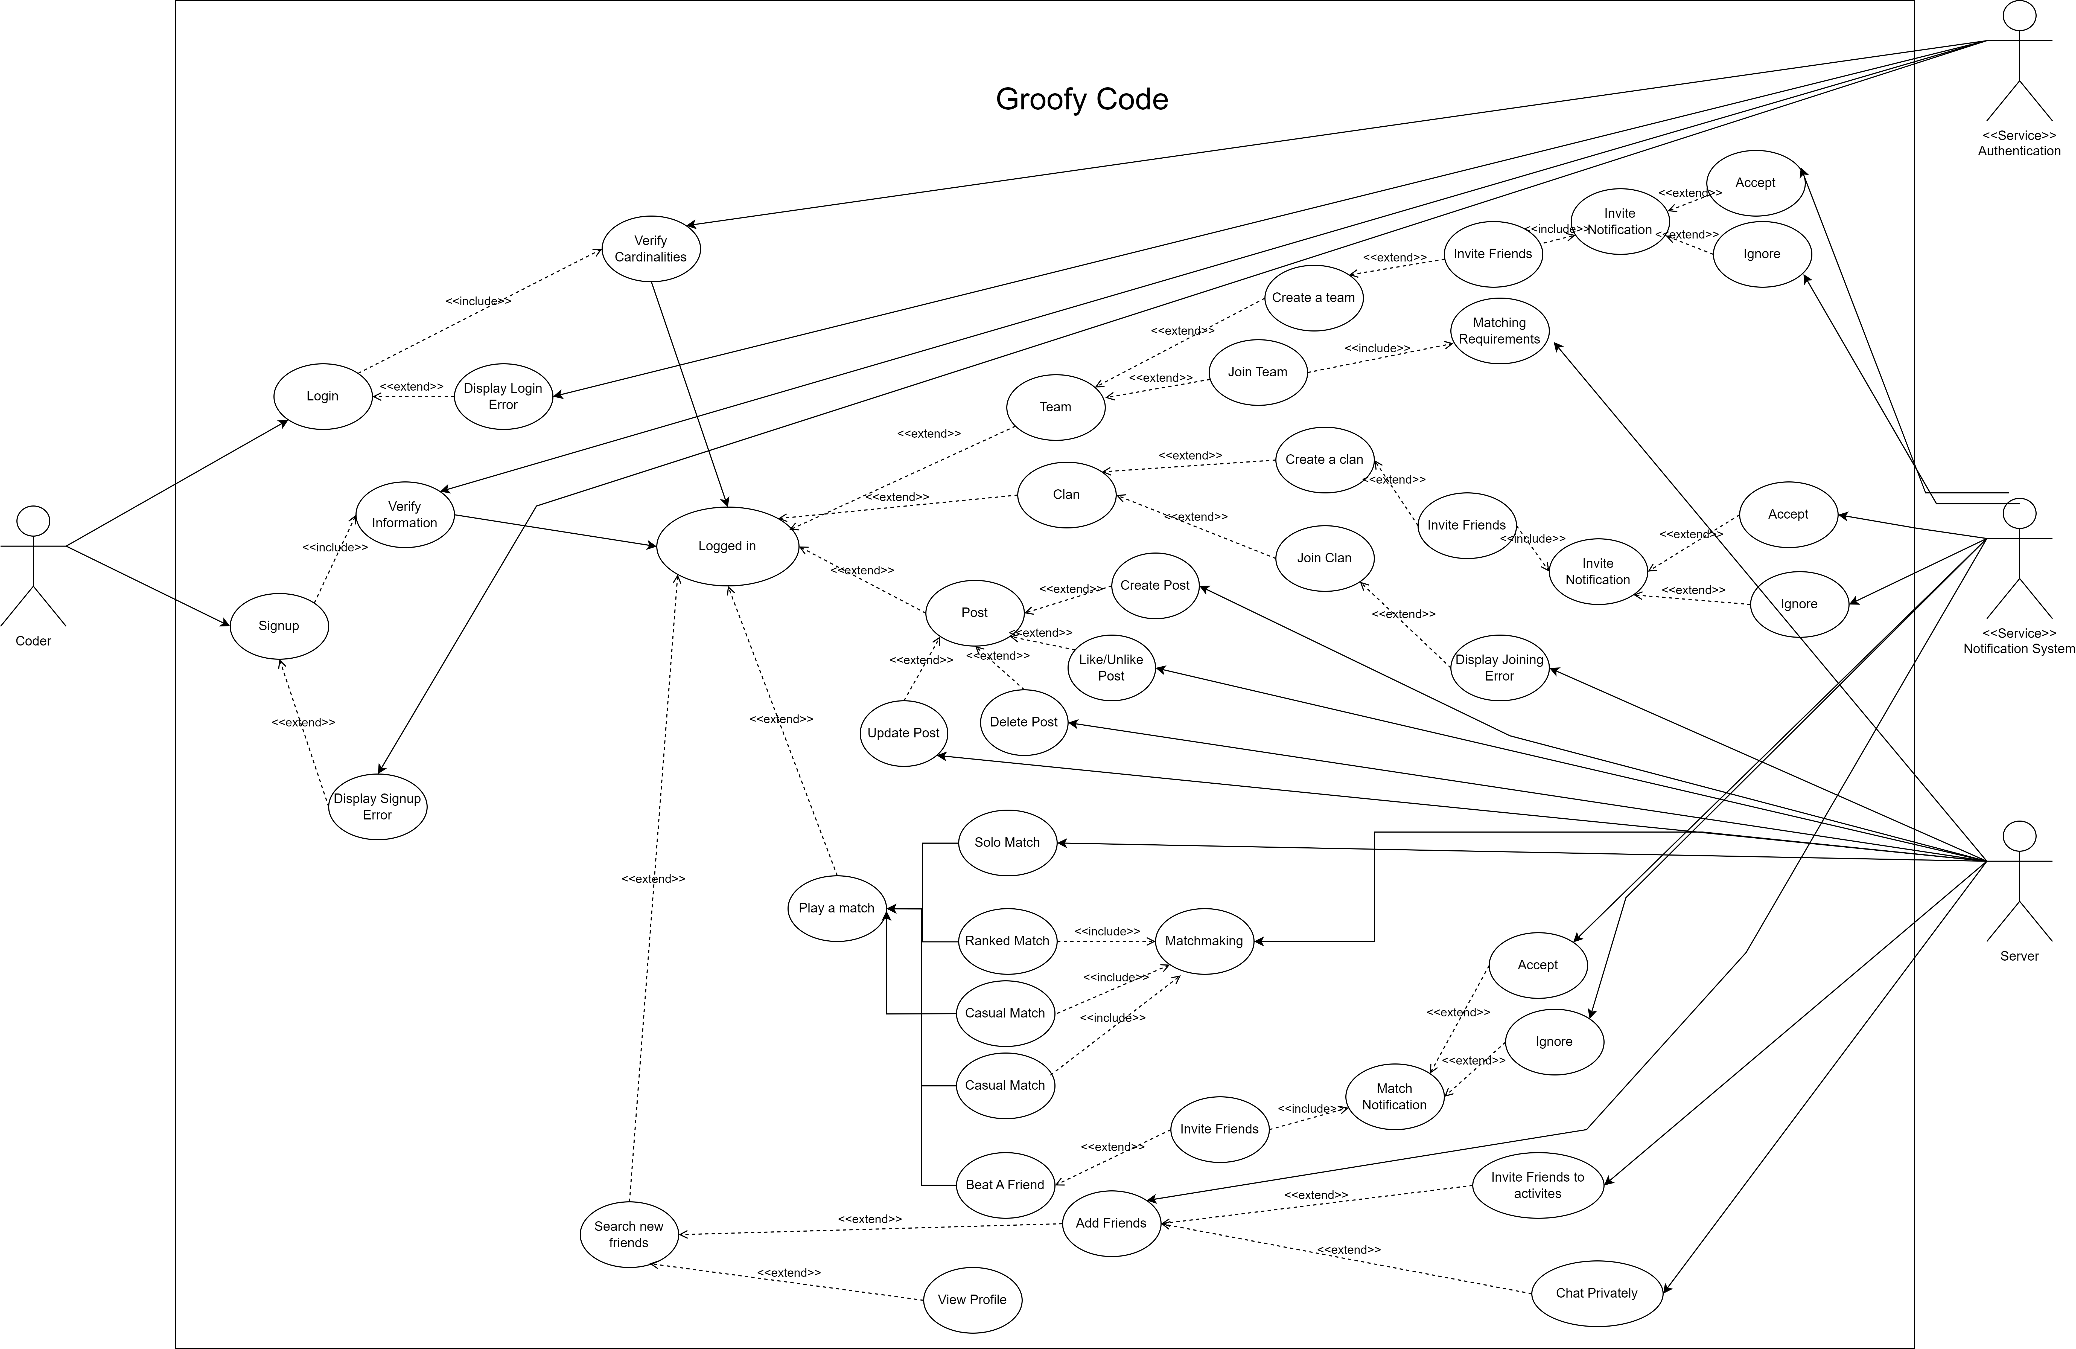
Use Case Diagram

Slide 20
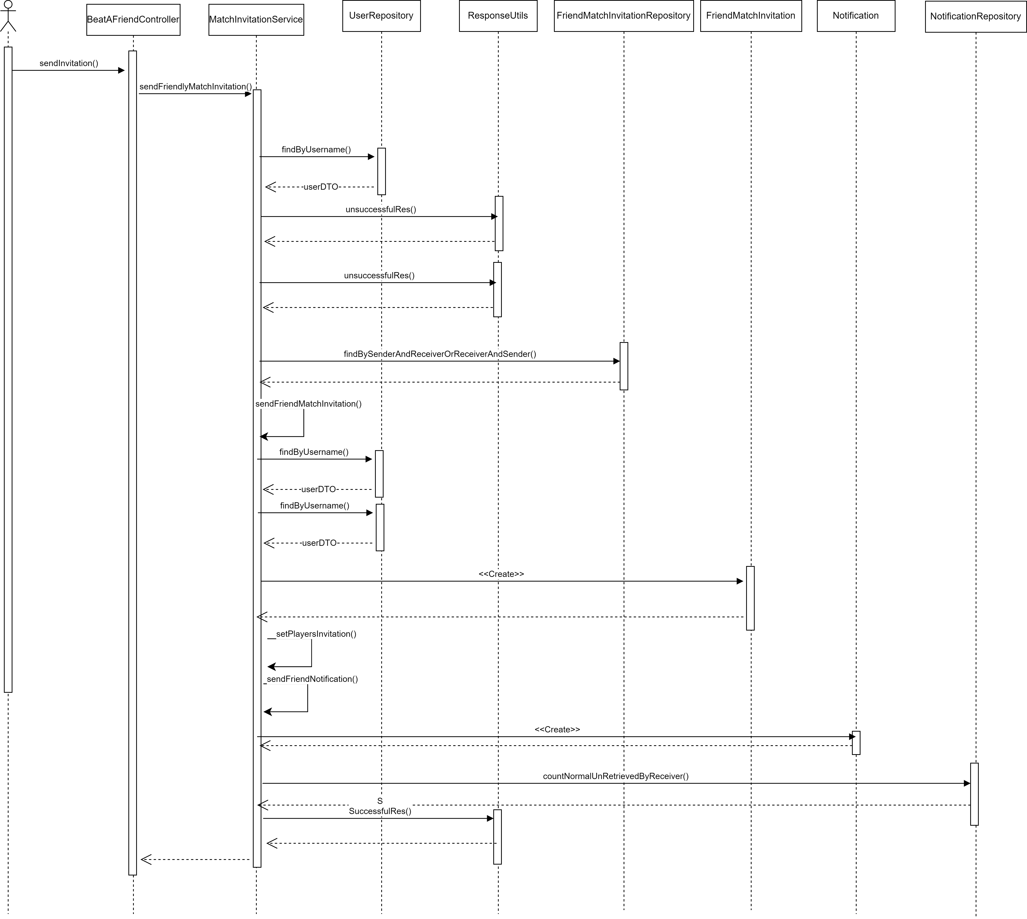
Send Invitation Friendly Match Sequence Diagram

Slide 21
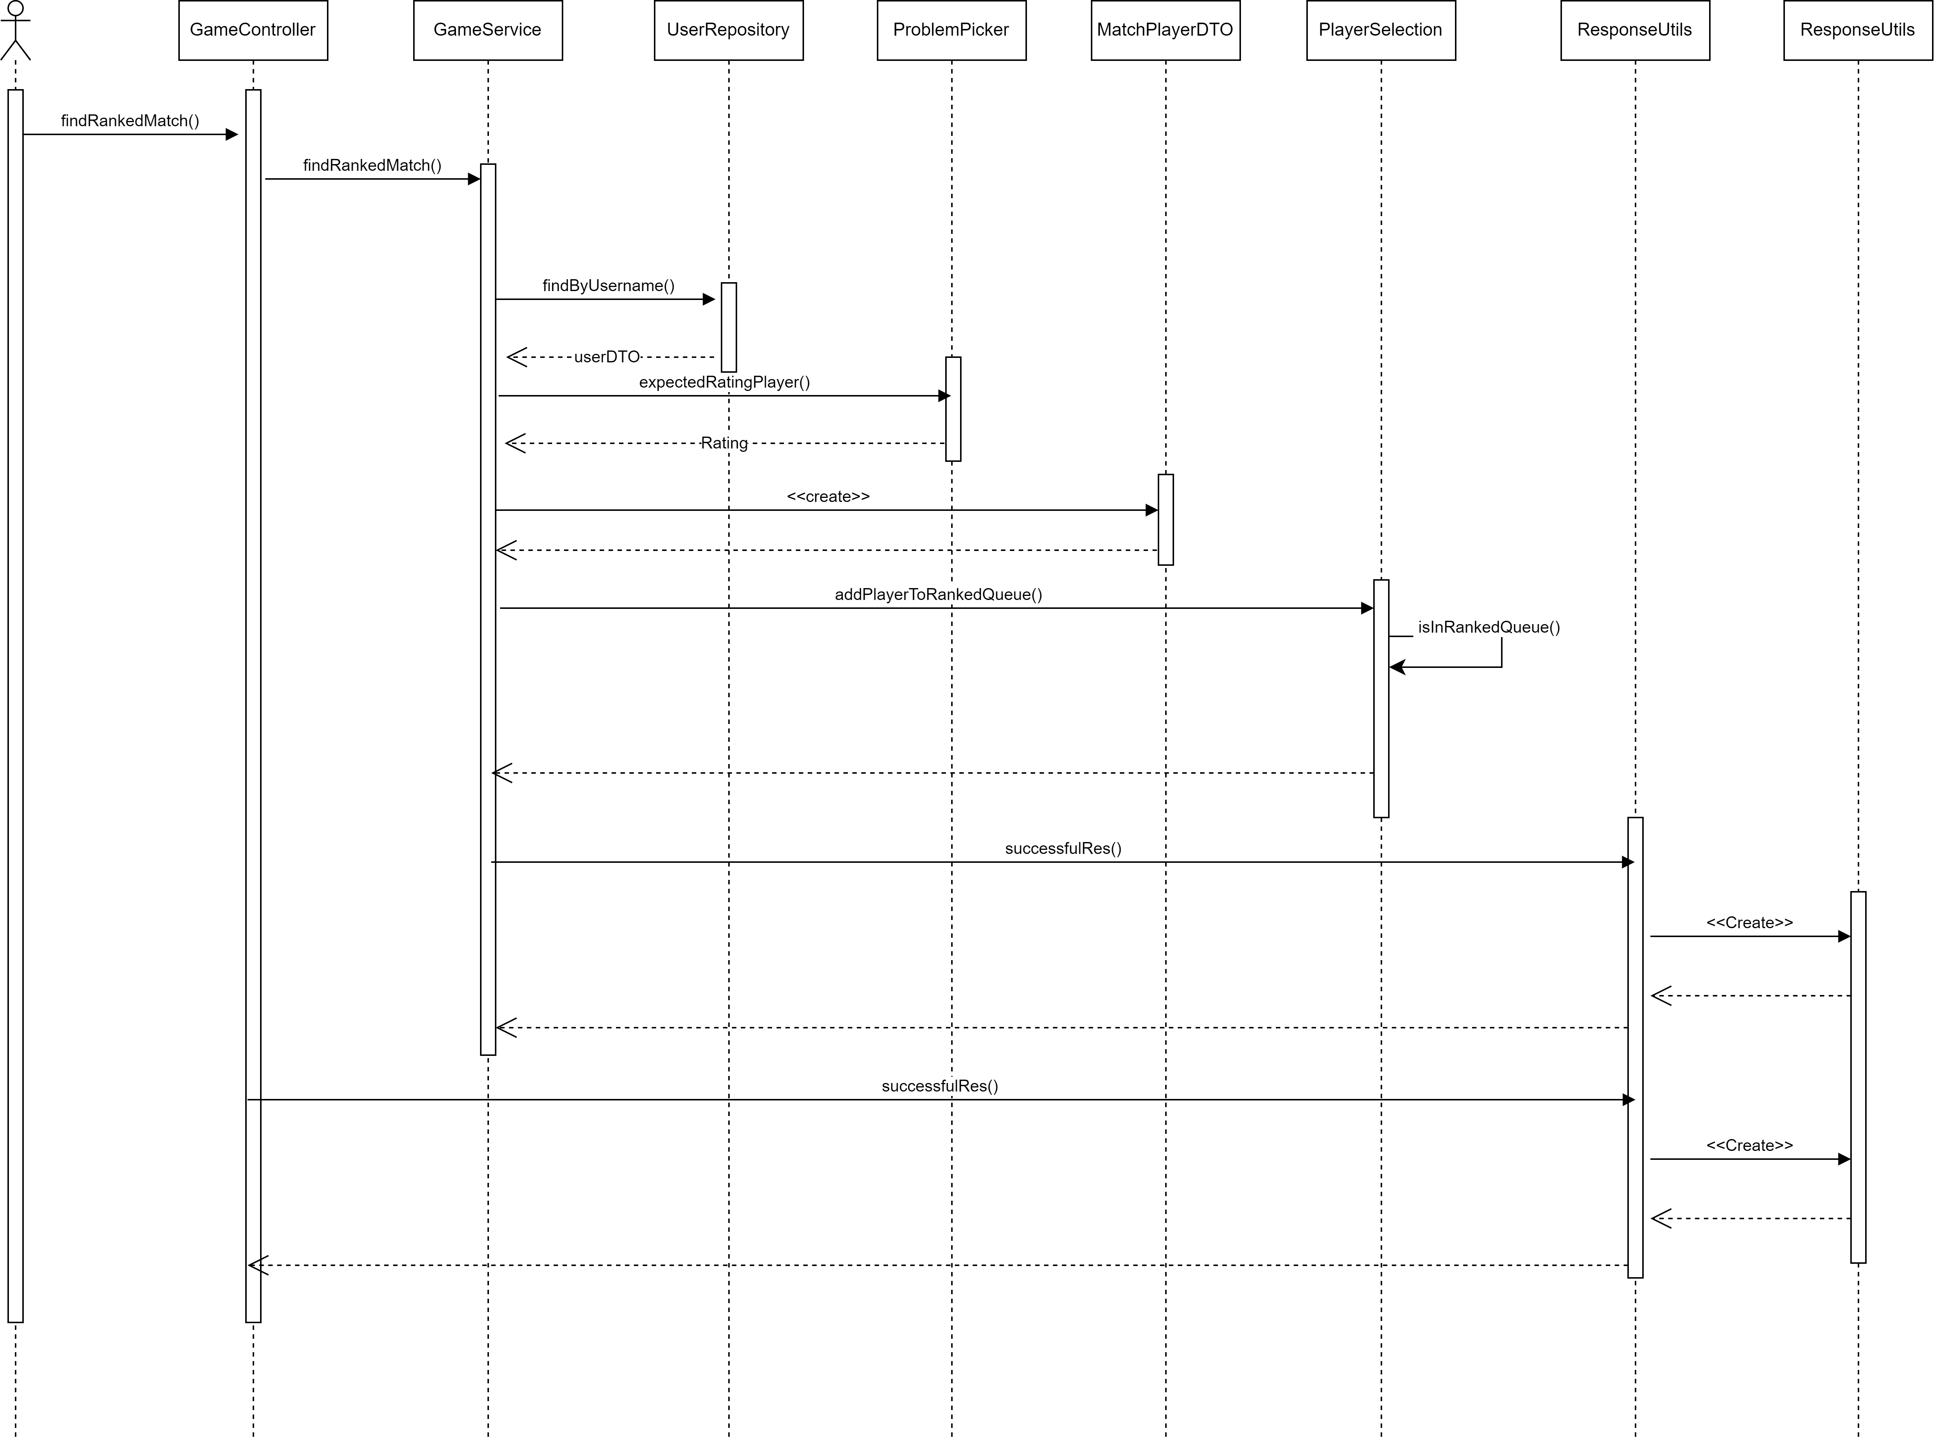
Ranked Match Sequence Diagram

Slide 22
Non-Functional Requirements
Scalability
Useability
Portability
Scaled Horizontally
-Friendly user interface
-At most 3 clicks
Media Query
Performance
Security
Reliability
Worest Response Time 2s
Passwords Encryption
Multi-layer Filters
Real-Time tracks and
updates

Slide 23
04
Technologies

Slide 24











Technologies & Libraries Used
Backend
JWT
Frontend
primereact
Trailwind css

Slide 25
05
Machine Learning

Slide 26
Machine Learning
Data Collection
Data Preprocessing
[ ]
Random Forest Regressor (Training)
Testing & Accuracy

Slide 27
Data Collection
50 ~ 60 K Records

Slide 28
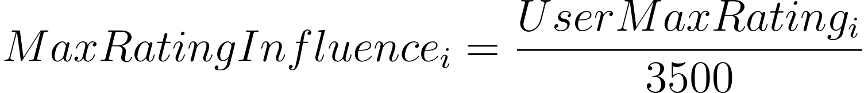
Data Preprocessing

Slide 29
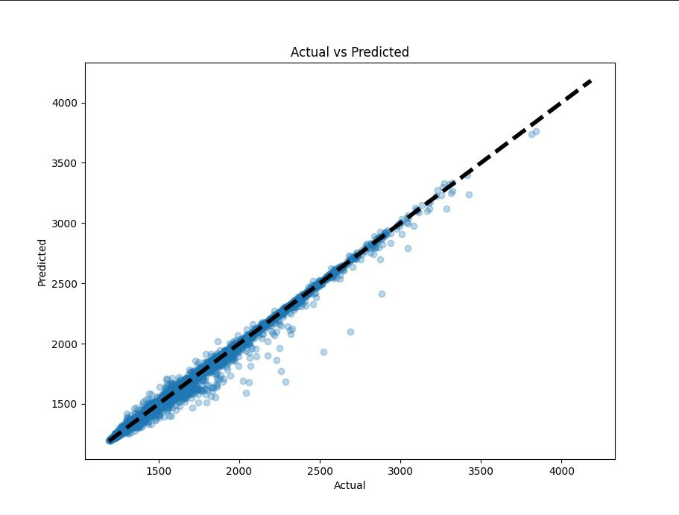
Actual vs Predicted Target

Slide 30
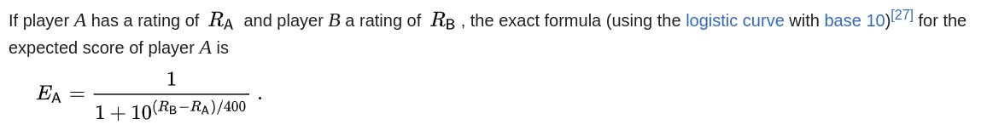
Elo System
Use Elo System Equation to calculate the rating change for winners and losers
Normalize the Change by factors

Slide 31
06
Challenges

Slide 32
Challenges
Node JS => Java Spring Boot
Supervised vs Unsupervised
ML
[ ]
Parser
Java Configuration Conflicts

Slide 33
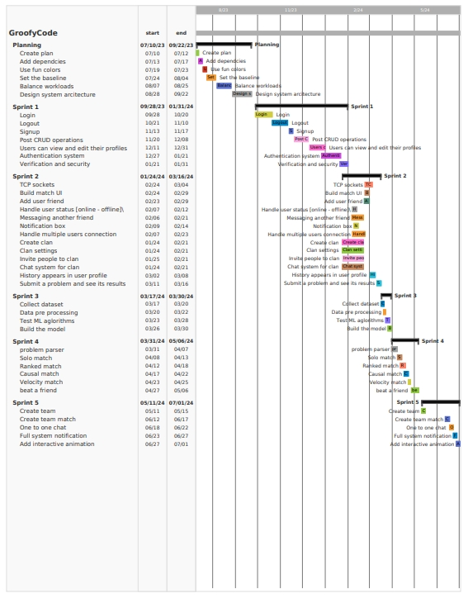
Gantt Chart & Agile

Slide 34
07
Demo

Slide 35
Thanks!
Thank you for your time and attention.

